Slide 1
myUNFI Advertising
2024-2025

Slide 2
myUNFI Advertising Options
Agenda Tracker
Benefits:
• Excellent brand exposure
• Ads link directly back to supplier’s Brand Page for instant ordering
• Ads change monthly – short lead time
Tier 1 (Web Ads)
Home Page Rotator
Home Page Static
Home Page Static with Text
Product Search
Shopping Cart
Browse Brands
Invoices
Tier 2 Ads (Web Ads)
My Lists
Order Status
Quick Entry
Reports
Browse Brands (Logo)
Tier 3 (Web Ads)
Publications
Most Purchased
Upload Spreadsheet
Browse Departments
New Products Page
Other
Custom Brand Page
Free Sample Program
Sponsored Search & Banner Ad
Brand Page Banner

Slide 3
Web Ads
01

Slide 4
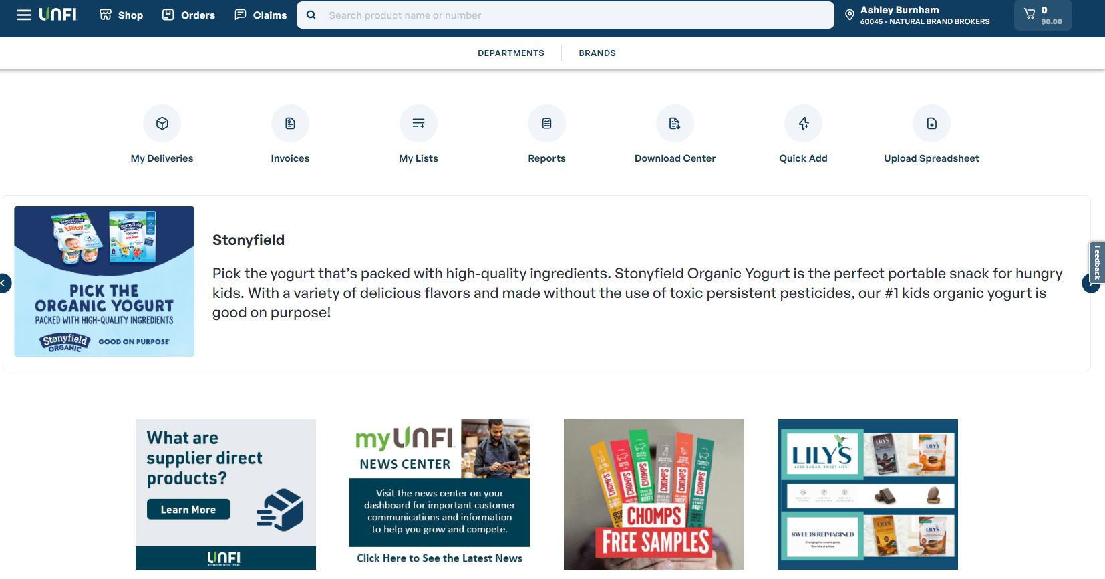


Home Page (Rotator & Static)
Agenda Tracker
Ad Sizes
Rotator: 300x250 pixels with text
Avg Impressions: 39,703
Avg Clicks: 257
Static: 300x250 pixels
Avg Impressions: 189,900
Avg Clicks: 81

Slide 5
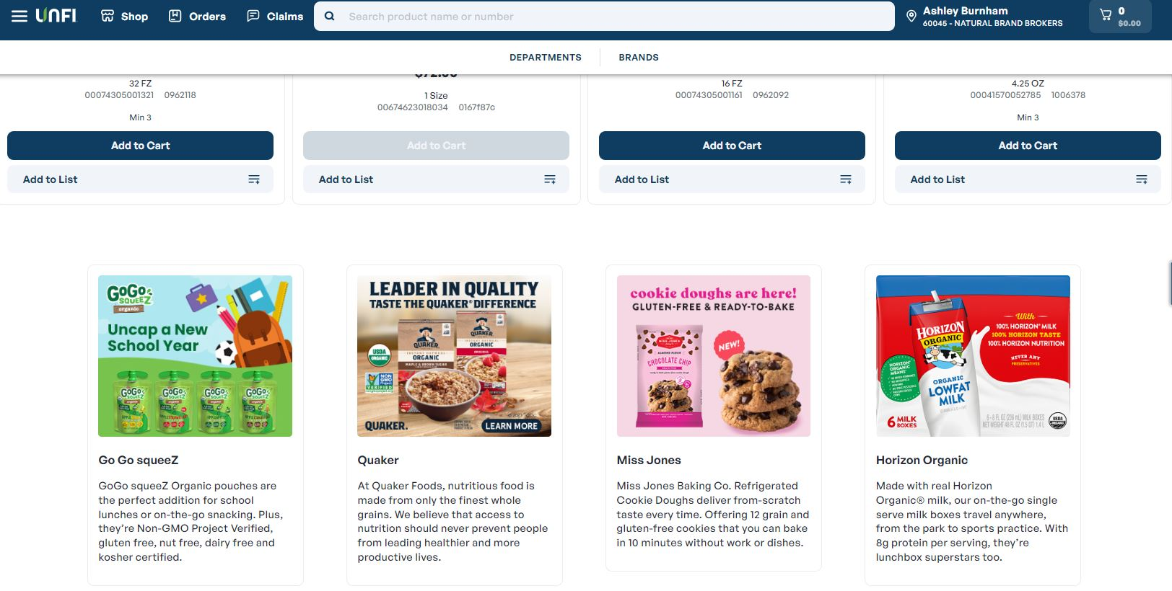
Home Page (Static with Text)
Agenda Tracker
Ad Size
Static with text: 300x250 pixels
Avg Impressions: 199,574
Avg Clicks: 48

Slide 6
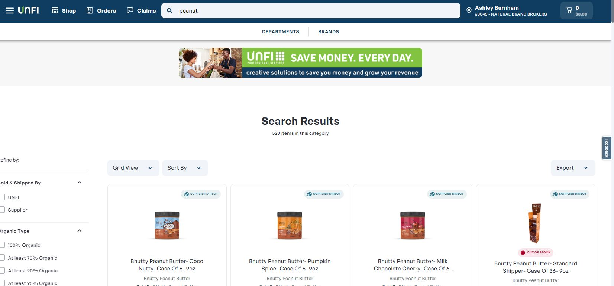

Search Page
Agenda Tracker
Ad Size
Search: 728x90 pixels
Avg Impressions: 206,444
Avg Clicks: 1,028

Slide 7
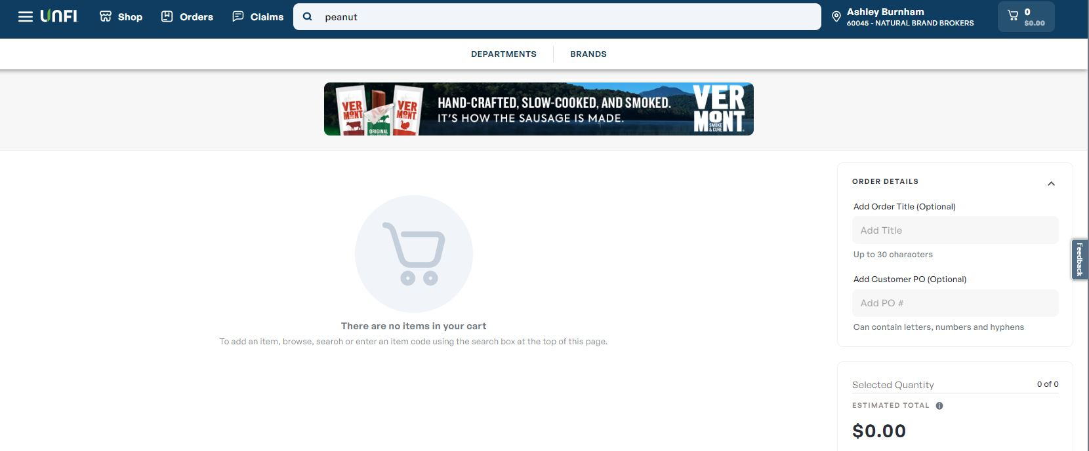
Shopping Cart
Agenda Tracker
Ad Size
Shopping Cart: 728x90 pixels
Avg Impressions: 72,346
Avg Clicks: 155

Slide 8
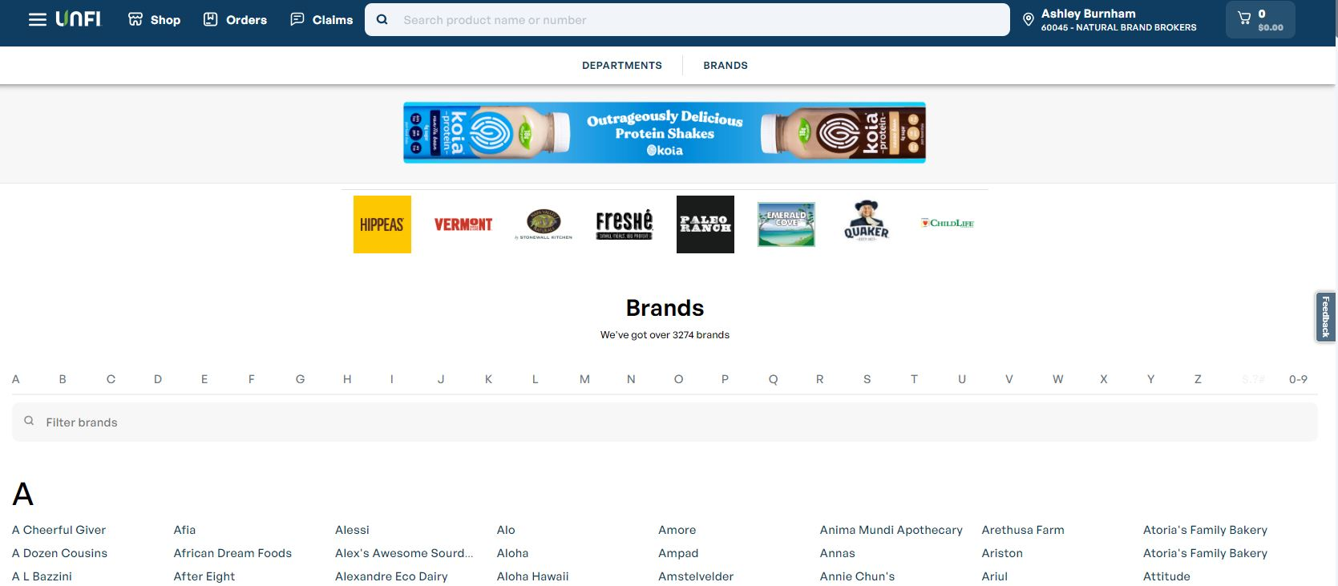
Browse Brands (2 Options: Banner Ad or Logo)
Agenda Tracker
Ad Size
Banner: 728x90 pixels
Avg Impressions: 144,666
Avg Clicks: 109
Logo: 300x300 pixels

Slide 9
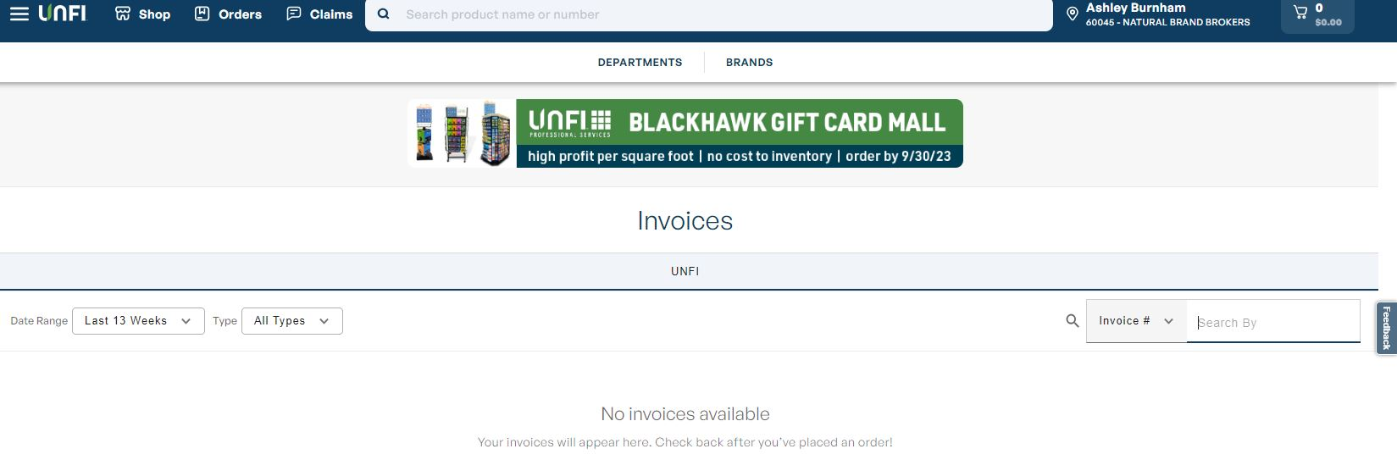

Invoices
Agenda Tracker
Ad Size
Invoices: 728x90 pixels
Avg Impressions: 24,448
Avg Clicks: 59

Slide 10
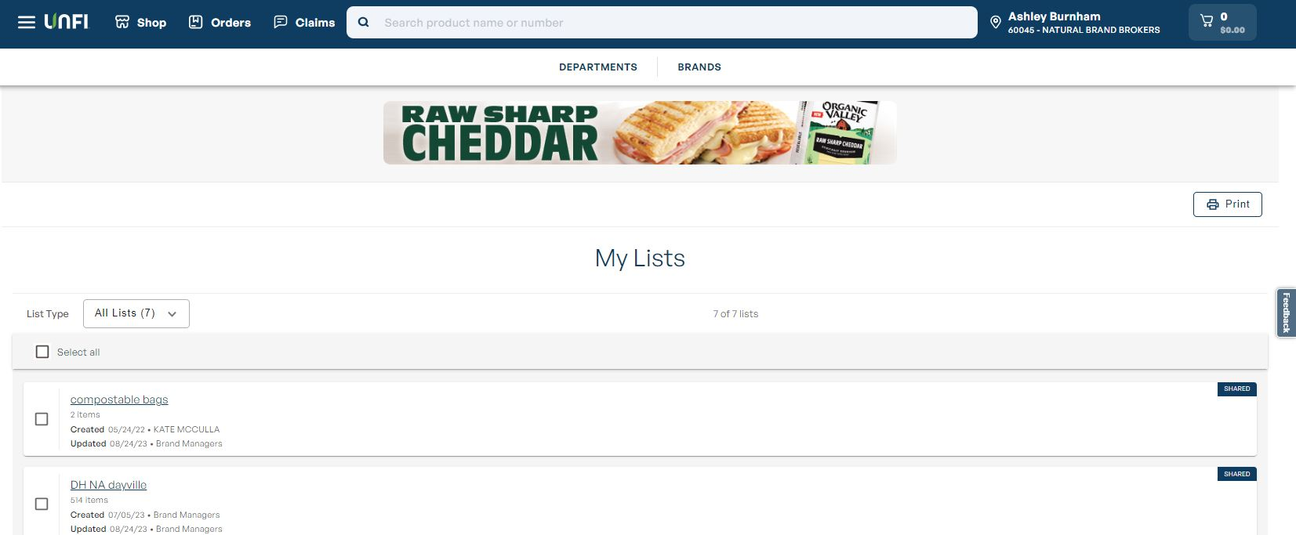
My Lists
Agenda Tracker
Ad Size
My Lists: 728x90 pixels
Avg Impressions: 17,353
Avg Clicks: 12

Slide 11
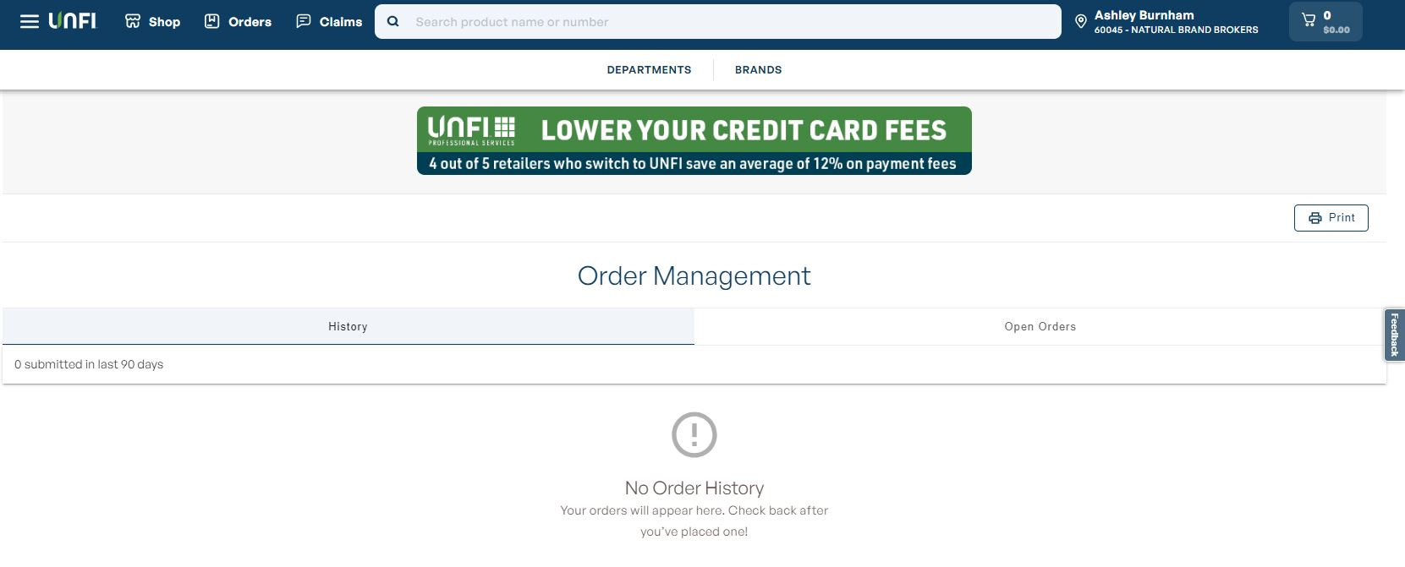
Order Status
Agenda Tracker
Ad Size
Order Status: 728x90 pixels
Avg Impressions: 27,847
Avg Clicks: 82

Slide 12
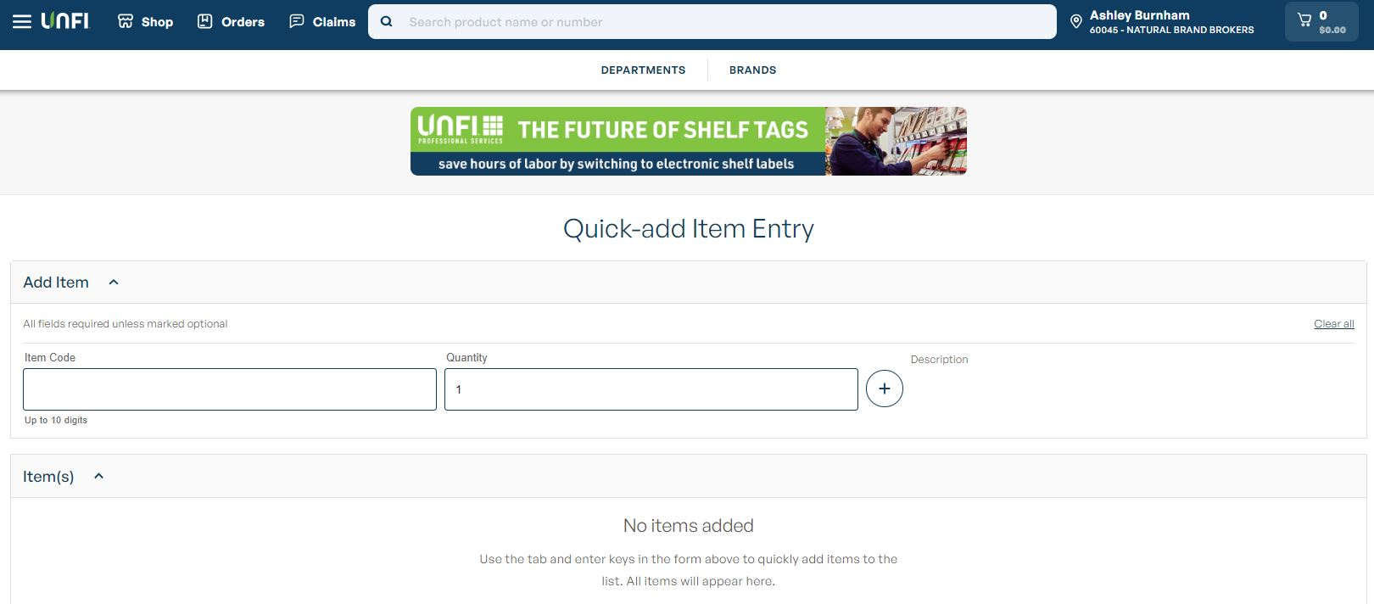
Quick Entry
Agenda Tracker
Ad Size
Quick Entry: 728x90 pixels
Avg Impressions: 4,286
Avg Clicks: 17

Slide 13
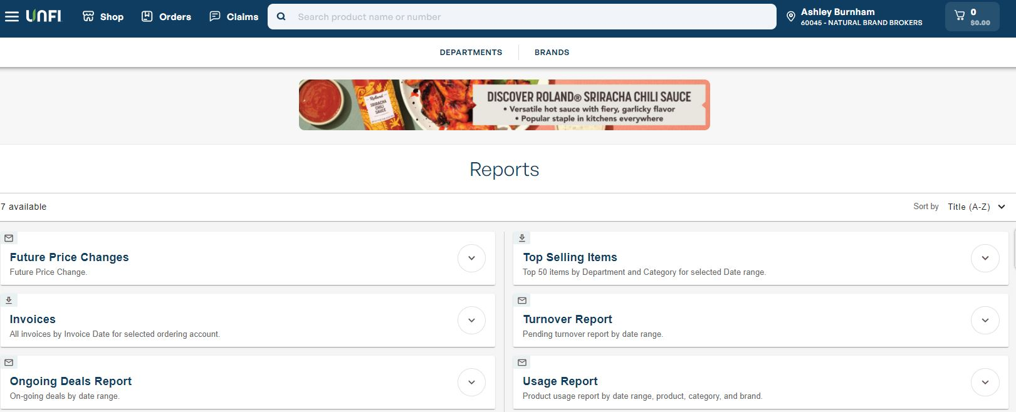
Reports
Agenda Tracker
Ad Size
Reports: 728x90 pixels
Avg Impressions: 4,428
Avg Clicks: 12

Slide 14
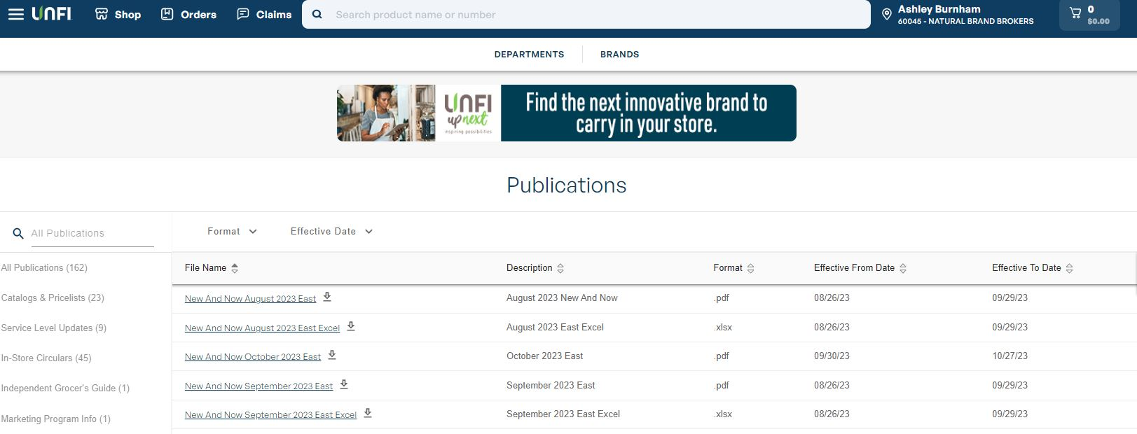
Publications
Agenda Tracker
Ad Size
Publications: 728x90 pixels
Avg Impressions: 1,546
Avg Clicks: 16

Slide 15
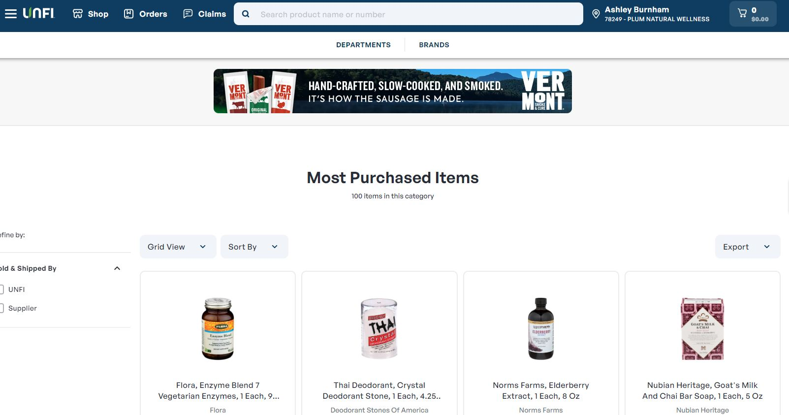
Most Purchased
Agenda Tracker
Ad Size
Most Purchased: 728x90 pixels
Avg Impressions: 3,745
Avg Clicks: 11

Slide 16
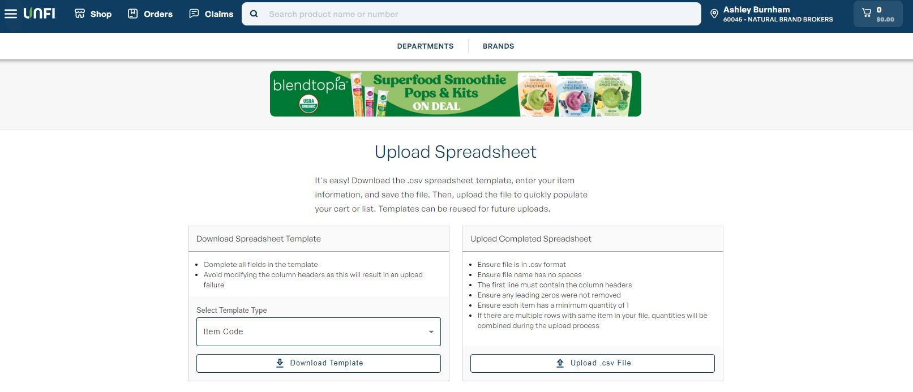
Upload Spreadsheet
Agenda Tracker
Ad Size
Upload Spreadsheet: 728x90 pixels
Avg Impressions: 6,252
Avg Clicks: 19

Slide 17
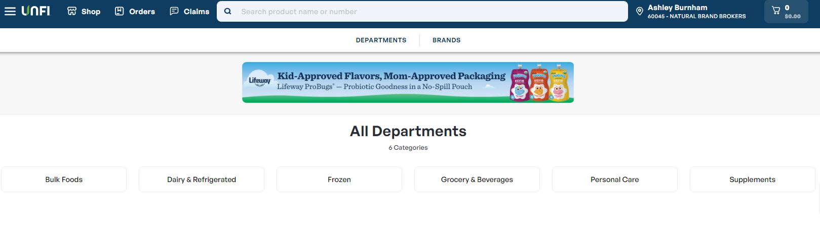
Department Landing Page
Agenda Tracker
Ad Size
Browse Departments: 728x90 pixels
Avg Impressions: 19,183
Avg Clicks: 41

Slide 18
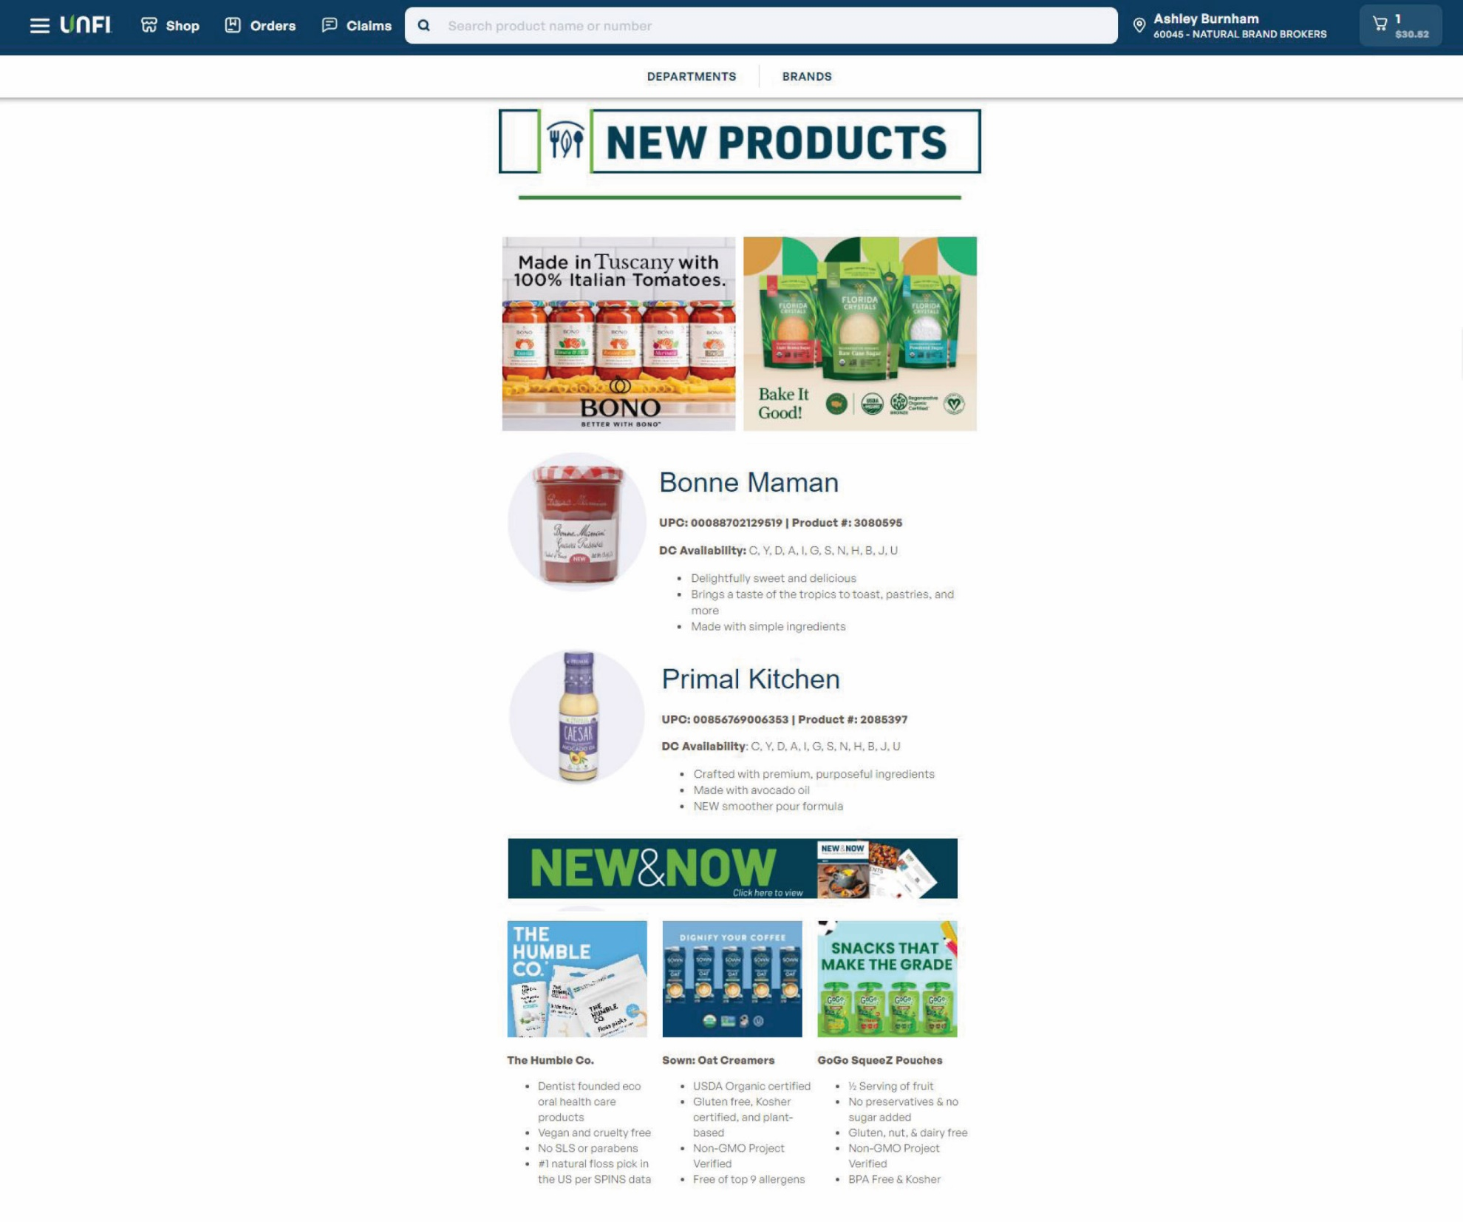
New Products Page (Large & Small with Text Options)
Agenda Tracker
Large ad option (300x250)
Ad Size
Large: 300x250 pixels
Small with Text: 180x150 pixels
Small ad with text option (180x150)

Slide 19
Other Web Offerings
01

Slide 20
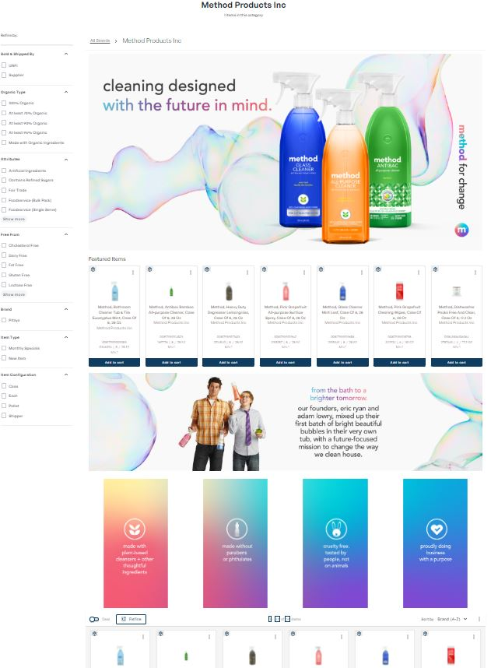
Custom Brand Page
Agenda Tracker
HEADER
Reinforce your branding with a large header featuring your logo, slogan, and brand imagery.
The new page design on myUNFI gives suppliers the option to fully customize their brand page
Powerful marketing tool
Reinforce branding/story
Introduce new products
Promote seasonal items
Suppliers can rank and feature up to 8 items of their choice
Option to update content 4 times/year
12-month term, automatically renews
Specs:
Logo: 96x96 pixels (at least)
Header: 3,000x1,500 pixels
Banner: 3,000x750 pixels
Content: 750x1,500 pixels
FEATURED ITEMS
Rank and feature up to 8 items of your choosing.
BANNER
Showcase a campaign, new items, seasonal products, or brand initiatives.
CONTENT
Each of the 4 vertical boxes may be customized with brand-specific content. Highlight new products, product attributes, certifications, and sustainability initiatives for example.

Slide 21
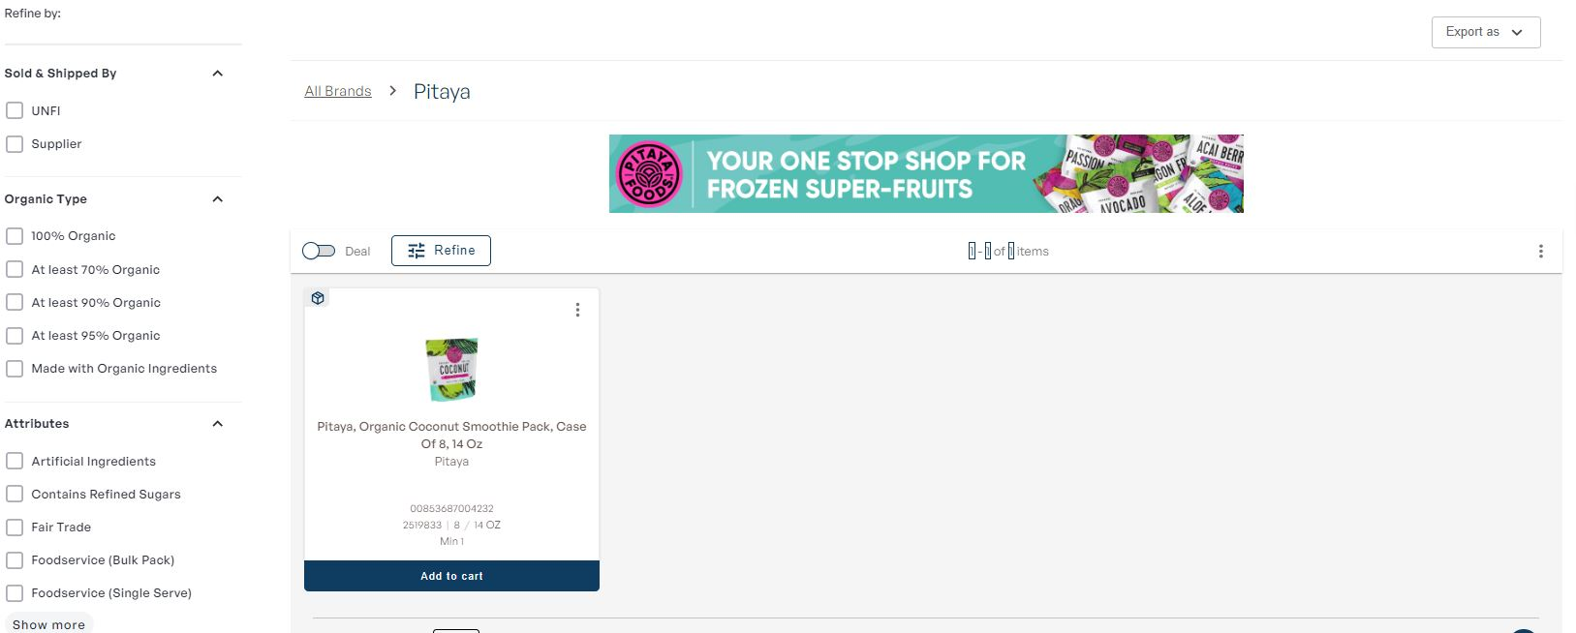
Brand Page Banner Ad
Customize brand page with a single banner ad
Reinforce branding/story with your own artwork
Option to update monthly
12-month term, automatically renews
Specs:
Banner ad: 728x90 pixels

Slide 22
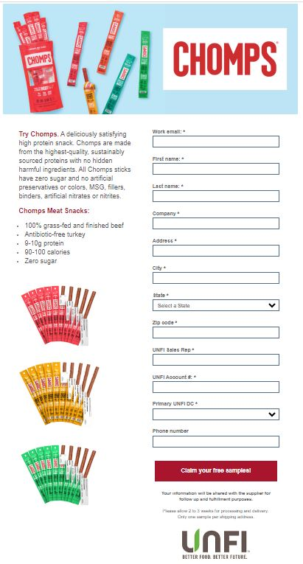
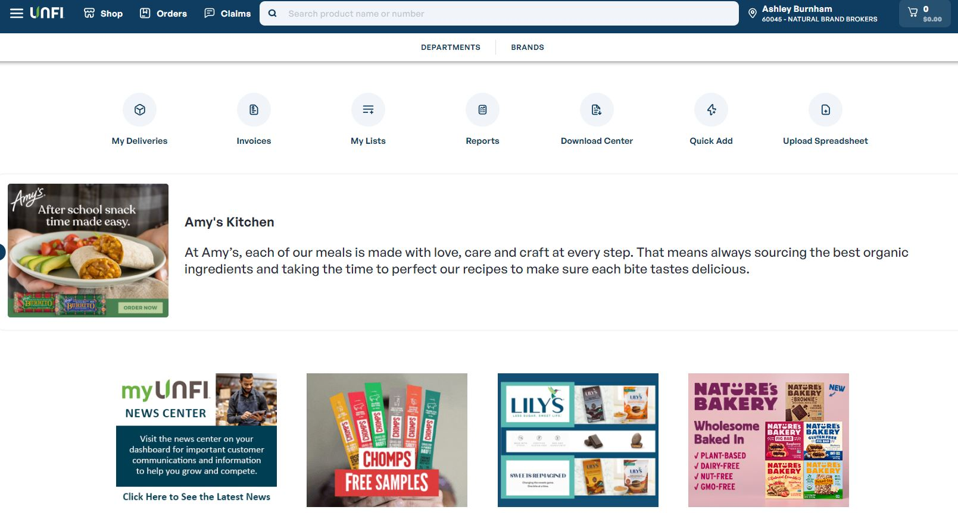
Free Samples Program
Agenda Tracker
One supplier per month
myUNFI home page ad clicks through to a Free Sample Request Form
UNFI tracks responses and sends to supplier
Supplier is responsible for fulfilment and any follow up
Supplier can determine the maximum number of samples sent

Slide 23
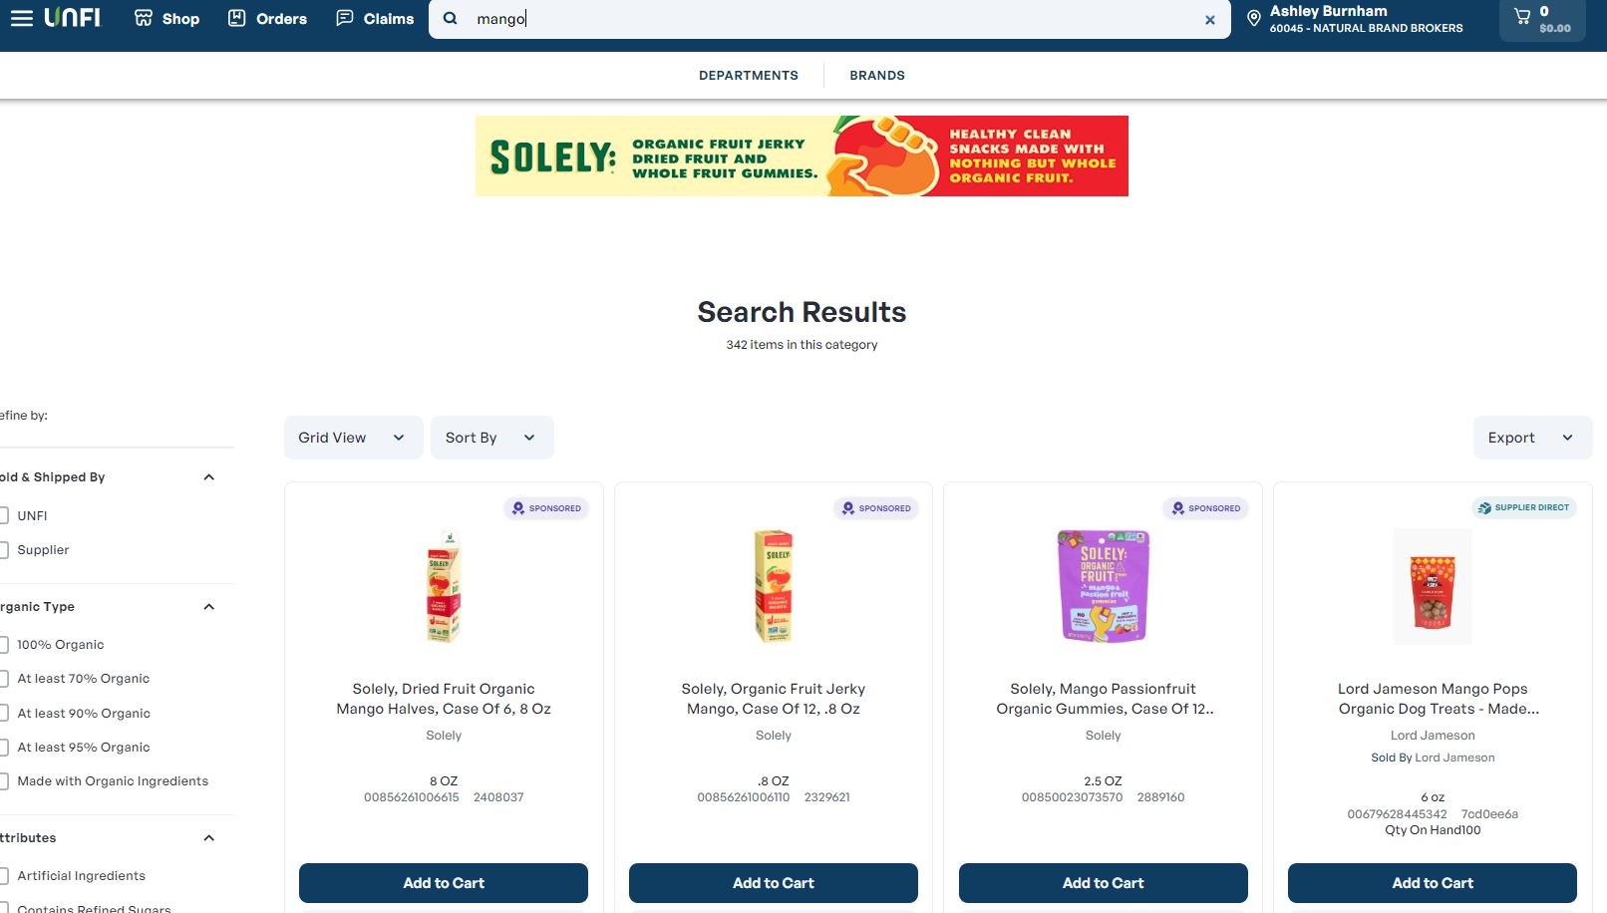
Sponsored Search & Banner Ad
Agenda Tracker
Suppliers can own up to 3 keywords on myUNFI
When their key word is searched:
Up to 3 of their items will be first to appear in the product listing
Their banner ad will appear at the top of the page and links to their Brand Page
Additionally, their banner ad will go into rotation on myUNFI for the first month of your promotion when customers search any term.
Keywords can be purchased in quarterly increments
Metrics including impressions and clicks will be provided at the end of your quarterly ad run

Slide 24
Thank You.

